Slide 1
Can you guess the Animals?
How to play:
Show your child the animal.
Ask the questions around the picture.
Give your child time to process the question.
Repeat the name of the animal and sound to encourage new vocabulary.
If you can think of more questions to ask your child, please do ask. This allows them to be exposed to different words and questions.
Encourage curiosity, let them ask questions.

Slide 2
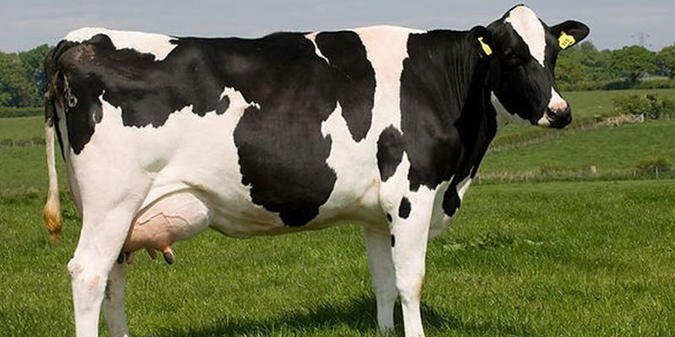
What is it?
What sound does it make?
Where does it live?

Slide 3
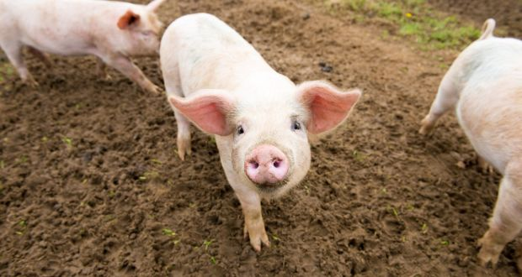
What is it?
What sound does it make?
Where does it live?

Slide 4
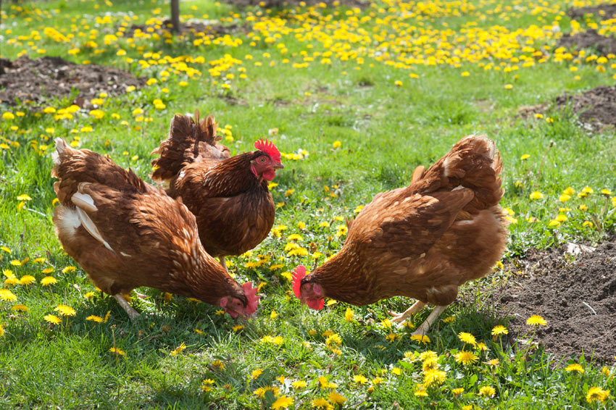
What are these?
What sound do they make?
How many are there?

Slide 5
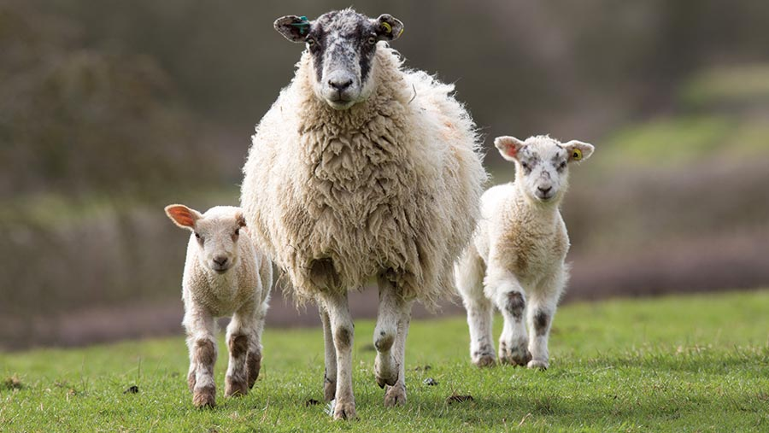
What are these?
What sound do they make?
Which one is the biggest sheep?

Slide 6
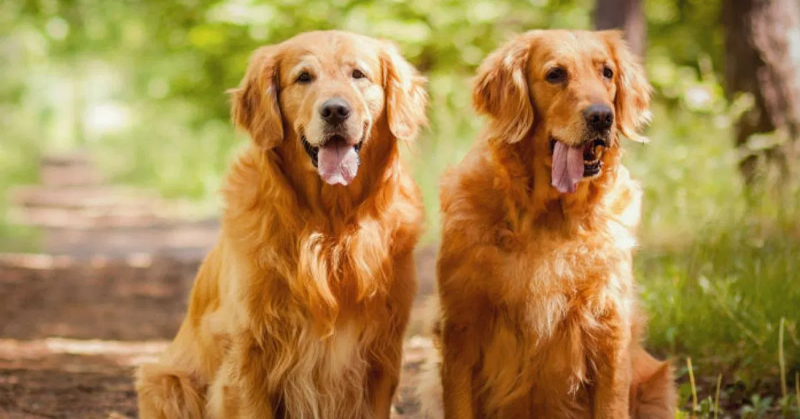
Do you have dog?
What are these?
What sound does it make?
How many are there?

Slide 7
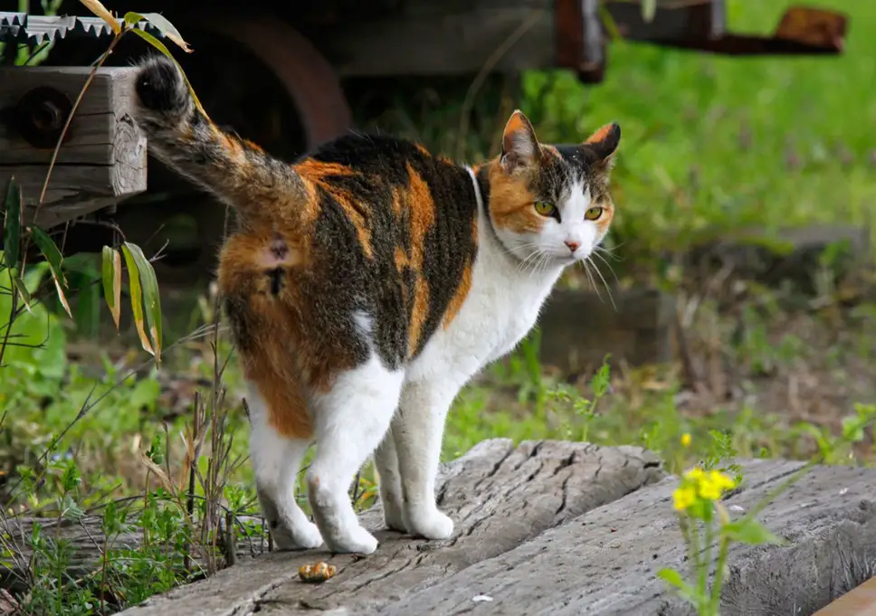
What is it?
What sound does it make?
Do you have a cat?

Slide 8
Activities…
Can you draw and colour in your favourite animal?
We would love to see your pictures when you come back! Or you can send a photo of them to school. Call the front office for the Early Years email address.
Join in singing ‘Old McDonald had a farm’!
https://www.youtube.com/watch?v=qirhfFzuK_4
Can you name the animals by listening to them?
These sounds are only available in the PowerPoint version of this document

Slide 9
Dear Children, Parents and Carers,
We would like to extend our thanks to you during this difficult time, we hope you are all safe and well, and are having lots of fun at home!
This activity focuses on Communication and Language. To meet the different headings under communication and language we have added audio for Listening and attention, questions for Understanding, and giving your child the opportunity to talk for speech. We hope you and your child enjoy this activity.
We hope the activities have helped keep you busy during this time and we will continue to make new resources for you to use.
During this time, we would like for you and your children to spend time with each other building upon their Personal, Social and Emotional Development and well-being ready for when they come back.
Thank you for your continued support ☺

